Slide 1

Visualizing Data Flight Data Visualizations
Project 3, Group 5
Adam Holcomb
Revathi Sundar
Ishan Chakrabarty
Simon Castellanos
Morteza Akbari

Slide 2
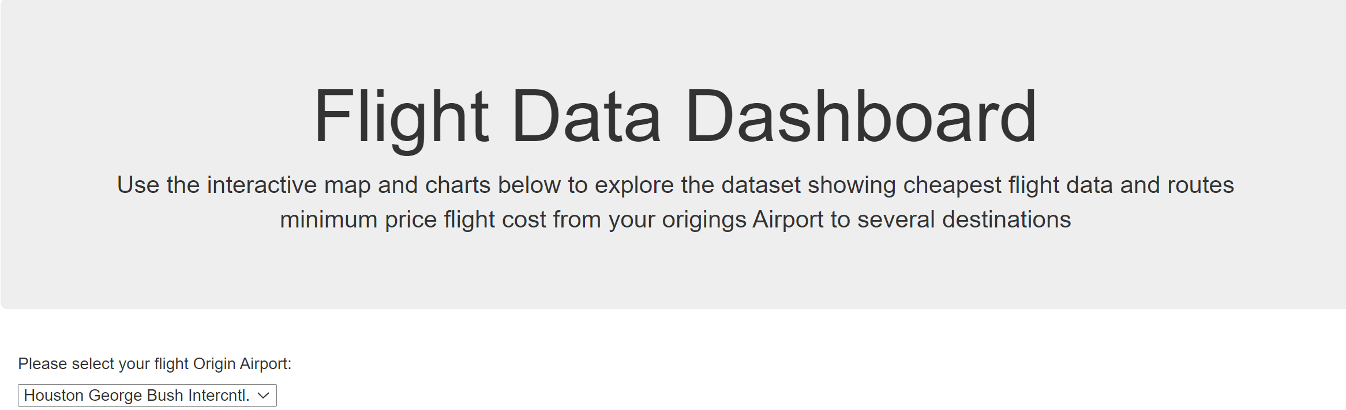
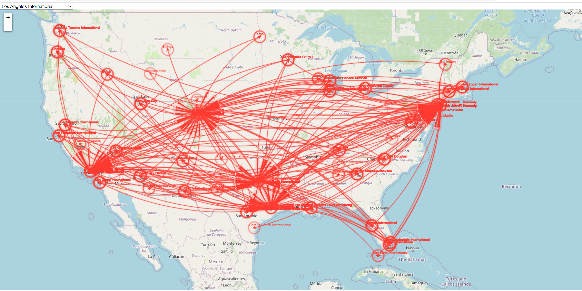
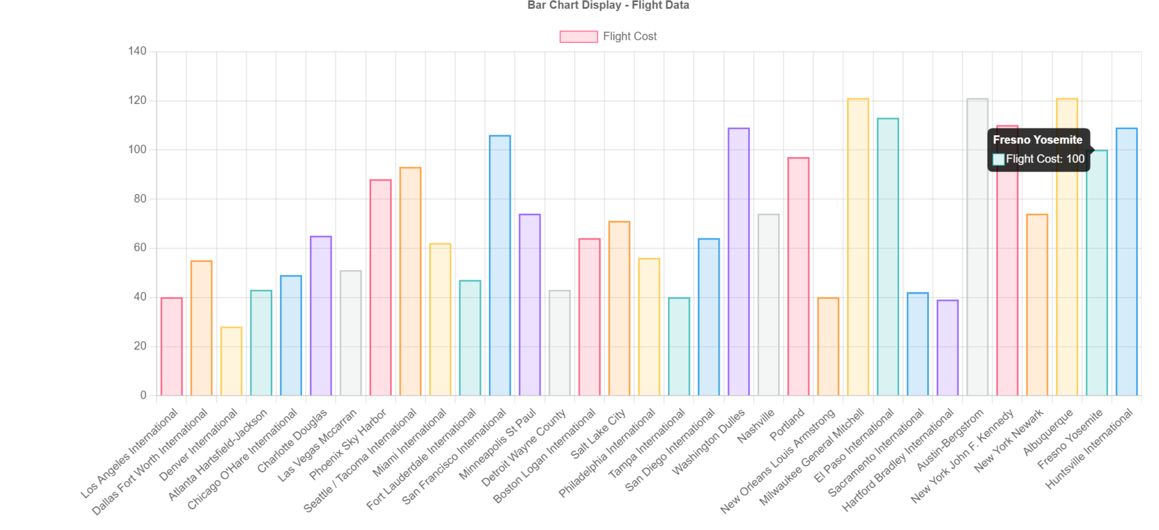
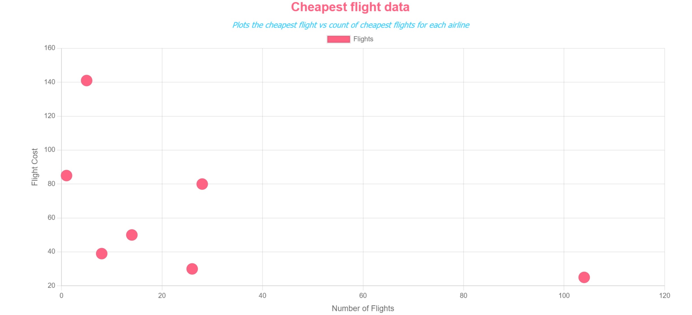
Dashboard Overview
Objective: to create website to view cheapest flight options in the United States

Slide 3
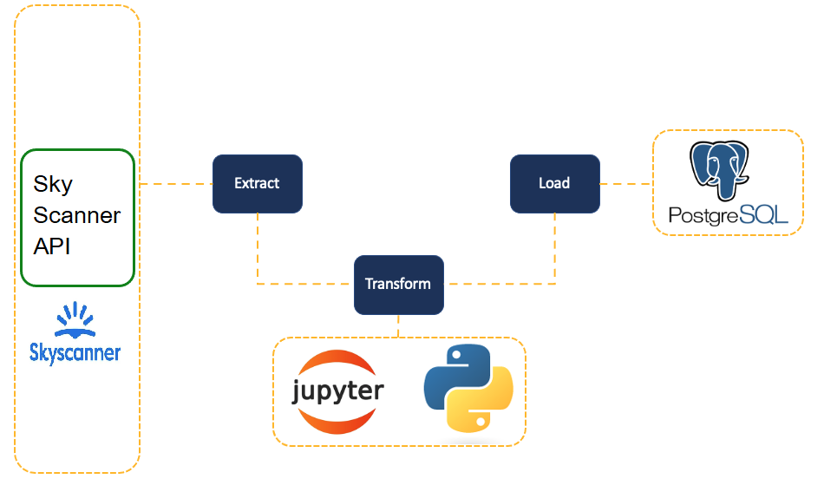
Agenda
Extract/Transform Data (Adam)
Pandas
API - Dataset record
Load (Revathi)
Python Flask
SQLAlchemy
HTML/CSS (Morteza)
JavaScript
Flight Map (Ishan)
Bar Chart (Morteza)
Bubble Chart (Adam)

Slide 4
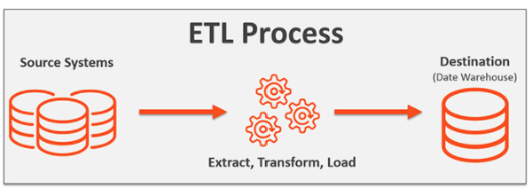
Extract/Transform Data
Skyscanner API
Imported flight data of cheapest flights from five origin cities to a group of destinations by looping through airport lists
Transform resulting JSON into dataframe resulting in 186 data points
Import airport lat/long coordinates
Transform csv into dataframe
Drop unwanted data
Merge dataframes
Export to csv for import to SQL

Slide 5
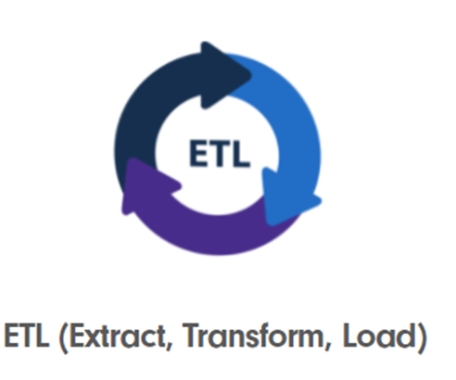
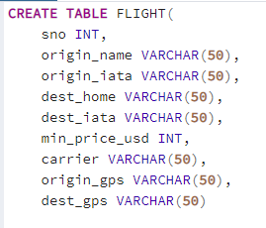
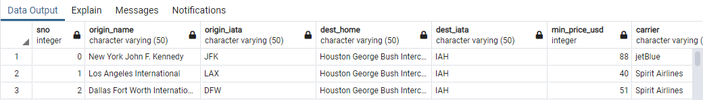
Load into SQL
Created SQL database using Postgres
Loaded csv from previous step
Created app.py to create Flask server
Split up data into separate APIs for each visualization

Slide 6

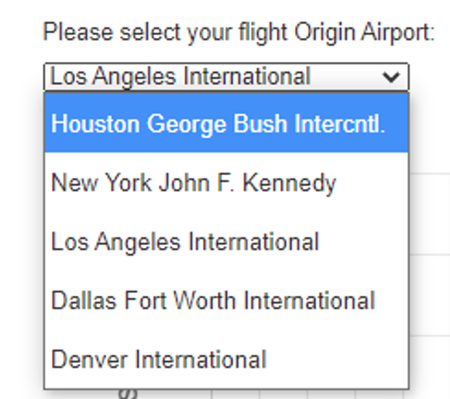
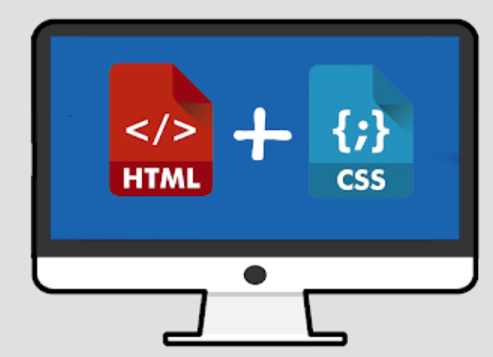
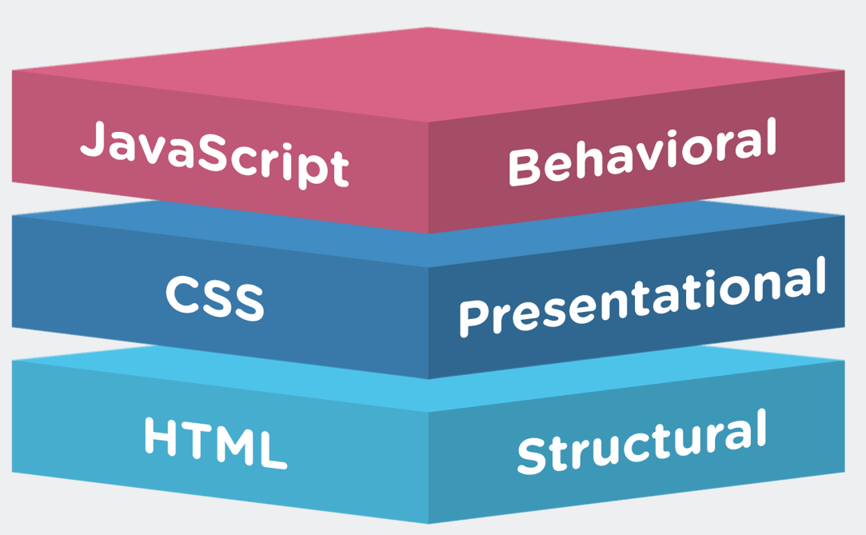
HTML/CSS
Used bootstrap to format site
Created dropdown menu
Imported each visualization JavaScript file independently
Map, Bar Chart, Bubble Chart
Linked to Migrationlayer, leaflet, D3, and chart.js libraries
Linked to CSS

Slide 7
Visualization 1 (Flight Map)
Used Leaflet and Migrationlayer
Utilized d3 to retrieve and loop through data
Maps flights from each origin city to their destinations
Interactive with dropdown menu of origin cities

Slide 8
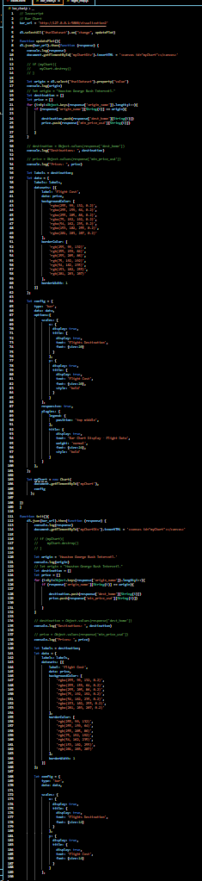
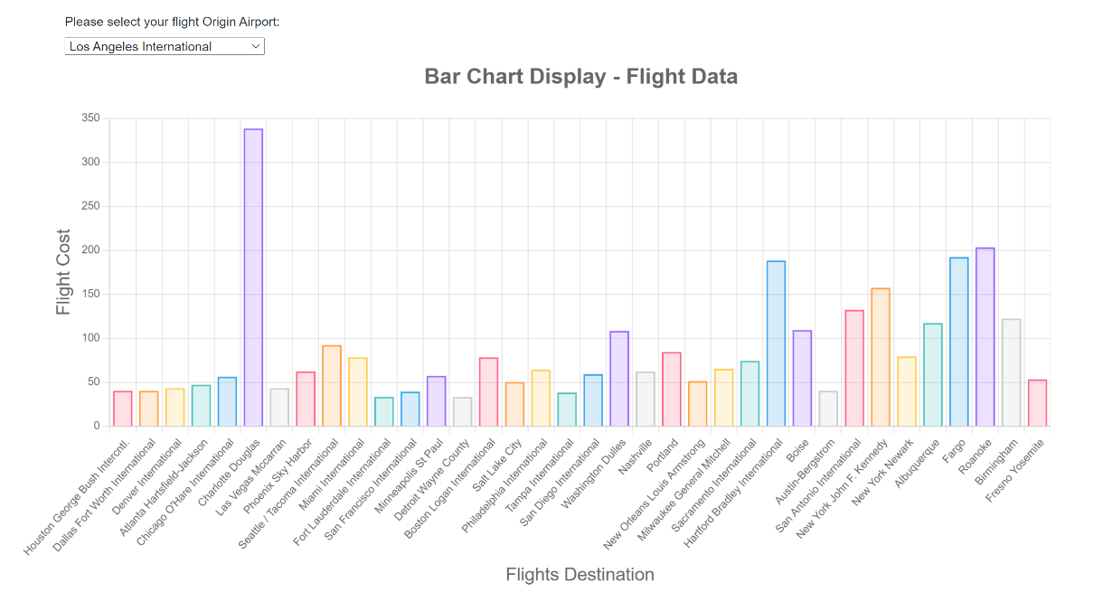
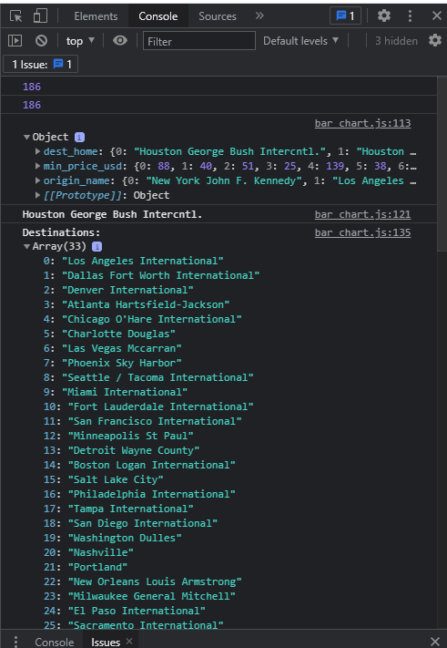
Visualization 2 (Bar Chart)
Data shows each destination and the cost to fly there
Used chart.js
Utilized d3 to retrieve and loop through data
Interactive with dropdown menu of origin cities
Used destroy within init() function to update chart with dropdown change

Slide 9
Visualization 3 (Bubble Chart)
Used chart.js
Graphs airline carrier vs the cheapest single flight cost for each carrier
Put data in x,y coordinate pairs

Slide 10
Specific Requirements
Your visualization must include a Python Flask–powered API, HTML/CSS, JavaScript, and at least one database (SQL, MongoDB, SQLite, etc.).
Your project should fall into one of the below three tracks:
A combination of web scraping and Leaflet or Plotly
A dashboard page with multiple charts that update from the same data
A server that performs multiple manipulations on data in a database prior to visualization (must be approved)
Your project should include at least one JS library that we did not cover.
Your project must be powered by a dataset with at least 100 records.
Your project must include some level of user-driven interaction (e.g., menus, dropdowns, textboxes).
Your final visualization should ideally include at least three views.

